Slide 1

Portfolio
Home
Case Studies
Outcomes
BRAND STRATEGY · CASE STUDY
Polaris
Academic Agents
“Guiding your journey.”
A pre-launch brand strategy engagement for a Kenyan study-abroad agency — repositioning the business, architecting its operating model, and preparing it to launch into an underserved market.
Market Research
Positioning
Operations
Go-to-Market
Identity
www.jktellsstories.africa
1

Slide 2
Portfolio
Home
Case Studies
Outcomes
Category: Brand Strategy.
Scope: Market Research, Positioning Strategy, Operational Strategy, Go-to-Market Strategy, Brand Identity.
Kenyan study abroad agencies heavily saturate the same territory: Nairobi, and the traditional UK/US/Canada routes. Polaris approached us pre-launch with a singular brief — find where they belong in this highly competitive market.
Insight.
Upon researching the market landscape, two critical gaps stood out. First, Western Kenya — specifically Kisumu and its surrounds — was significantly underserved compared to Nairobi. Second, the continent of Africa was barely being pitched as a viable study destination. The recommendation was a strategic pivot: launch from Kisumu instead of Nairobi, and position elite African institutions as high-value alternatives alongside Western routes.
Research
Positioning
Operations
Go-to-Market
Identity
www.jktellsstories.africa
2

Slide 3
Portfolio
Home
Case Studies
Outcomes
Intervention
PART ONE — POSITIONING & OPERATIONS
THE JOURNEY WE BUILT
Brand Positioning:
1
First Inquiry
We moved the brand away from the transactional destination-list model. Polaris was positioned as a comprehensive guide offering full-journey support based on lived experience — present and honest about the realities of studying abroad, from the first application through the crucial first weeks in a new country.
Initial contact & discovery
2
Admissions
Application & institution match
3
Visas
Operational Architecture:
Documentation & approvals
Designed a day-to-day operational model spanning first inquiry, admissions, visas, and post-arrival check-ins. This framework was built specifically to scale from Kisumu across Kenya and East Africa without requiring a rebuild at each growth stage.
4
Post-Arrival
Check-ins after landing
Built to scale from Kisumu across Kenya and East Africa — without a rebuild at each growth stage.
www.jktellsstories.africa
3

Slide 4
Portfolio
Home
Case Studies
Outcomes
Intervention
PART TWO — GO-TO-MARKET & IDENTITY
STUDENTS
Go-to-Market Strategy:
Instagram
TikTok
Segmented the messaging to address the dual-audience dynamic. We developed story-led, aspirational content for students on Instagram and TikTok, paired with cost- and safety-focused communications for parents and financial sponsors on Facebook and WhatsApp.
Story-led, aspirational content built around lived experience — confident, honest, and unafraid of the harder parts of the journey.
Identity & Corporate Infrastructure:
PARENTS & SPONSORS
Built the foundational brand to carry this vision, including the name, tone of voice, visual identity, and the tagline, “Guiding your journey.” We also facilitated the legal and structural setup, driving company incorporation, tax registration, CUE licensing, and the groundwork for ICEF/London Statement compliance.
Facebook
WhatsApp
Cost- and safety-focused communication, built to reassure the people funding and approving the journey.
www.jktellsstories.africa
4

Slide 5
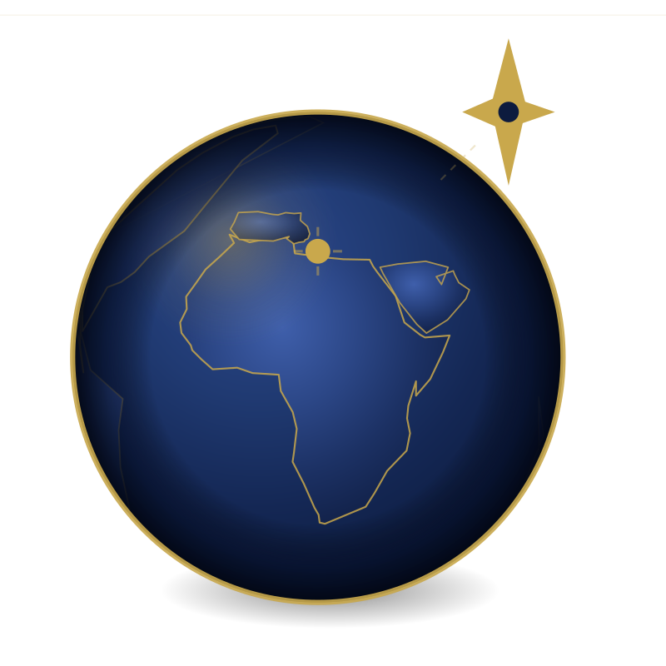
Portfolio
Home
Case Studies
Outcomes
Outcomes
The engagement delivered a comprehensive, market-ready business architecture — equipping the founders to launch with confidence.
01
A finalized brand identity — name, tone of voice, visual system, and tagline — ready to carry the business to launch.
02
A resilient operating model spanning inquiry to post-arrival, built to scale from Kisumu across East Africa.
03
A targeted go-to-market strategy positioned to capture an underserved market segment.
“Guiding their journey — from strategy to launch.”
www.jktellsstories.africa
5

